Slide 1
Web sockets

Slide 2
Agenda
How HTTP protocol works.
What are Websockets and how it works.
What is Transmission Control Protocol (TCP).
Where Websockets used.
Advantages of Websockets.
Disadvantages of Websockets.

Slide 3
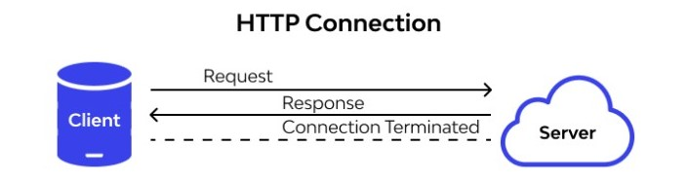
How HTTP protocol works
In HTTP protocol client sends the request and the server sends the response. Each request is associated with a corresponding response , after the response is sent and connection gets closed each HTTP or HTTPS request establishes a new connection to the server every time.
http protocol are uses http colon and double slash (http://) to connect with web.(Ex - http://www.google.com).

Slide 4
What are Websockets.
Websocket is a computer communications protocol, providing full-duplex communication channels over a single TCP (Transmission Control Protocol) connation and it is persistent connection between a client and server.
Websockets are uses ww or wws colon and double slash (ww://) to connect with web. (Ex – ww://www.google.com)

Slide 5
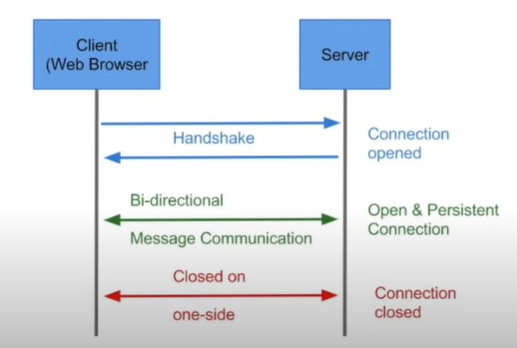

Slide 6
What is Transmission Control Protocol (TCP)
TCP is a connection-oriented protocol. Connection-orientation means that the communicating devices should establish a connection before transmitting data and should close the connection after transmitting the data.
It breaks large amount of data in the form of smaller packets and delivers it to the client across the internet and ensure the successful delivery of data and messages over networks.

Slide 7
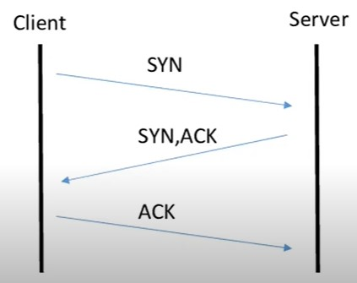
Three-Way Handshake or a TCP 3-way handshake is a process which is used in a TCP/IP network to make a connection between the server and client. It is a three-step process that requires both the client and server to exchange synchronization and acknowledgment packets before the real data communication process starts.
Syn - Used to initiate and establish a connection. It also helps you to synchronize sequence numbers between devices.
ACK - Helps to confirm to the other side that it has received the SYN.

Slide 8
Where Websockets used.
Google Docs.
Multiplayer games.
Multimedia chat.
Sports Updates.

Slide 9
Advantages of Websockets
It allows for two-way communication.
Websockets allow you to send and receive data much faster than HTTP. They're also faster than AJAX.
Compatibility between platforms. (web, desktop, mobile)

Slide 10
Disadvantages of Websockets
A fully HTML5-compliant web browser is required.
AJAX-like success mechanisms are not available in Websockets.
HTTP is significantly easier to develop if your application doesn’t take a lot of dynamic interaction.

Slide 11
THE END

